Slide 1


“Employee CICD”
Submitted by: Shashwat Kumar
Submission type : Individual
Name:
Batch :1
LMS Id :
Program : HDFC API developement
Date: 28/4/2023

Slide 2

Table of contents
Introduction
Project Overview
Technology Stack
Gradle build and Project structure
Architecture Design
Encryption and Decryption
Testing
Automation Shell Script
Remarks
Refrences

Slide 3
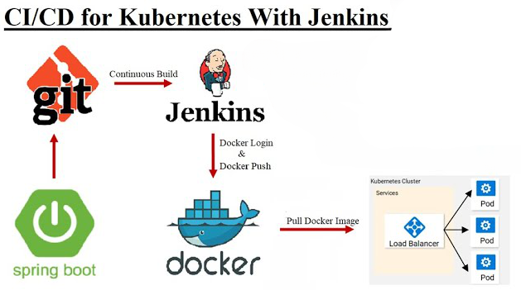
Introduction
The api is created using spring boot to demonstrate creation of REST API and fully automating the build and deployment on kubernetes using jenkins CICD

Slide 4
Project Overview
A srping boot app is created,it is fully automated using jenkins CICD.
The Deployment is done on Docker.
The Service program uses AES-256 encrption for encrypting sensitive data and the decrytion is done in client program.
The Employee Service runs on https, The client calls this service using custom rest template which performs SSL validation .
The docker Images are created, pushed to docker-hub and deployed on kubernetes using shell script on jenkins

Slide 5
Technology Stack
Maria DB (SQL)
Java springboot
JPA
Springweb
Validations
logback
Postman
Jenkins
Docker
Kubernetes

Slide 6
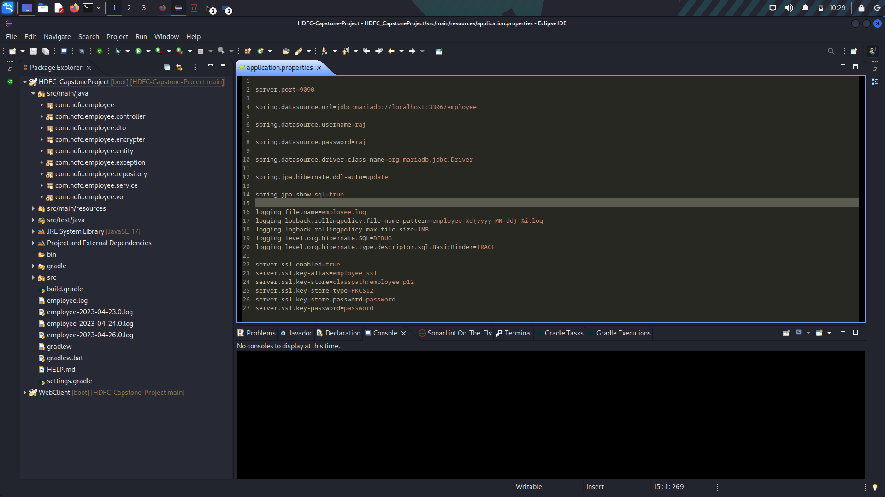
Gradle Build and Project Structure

Slide 7
Architecture Design
DTO
Controller
Service
Repository
3
4
2
7
9
1
8
5
POSTMAN
VO
Database
9

Slide 8
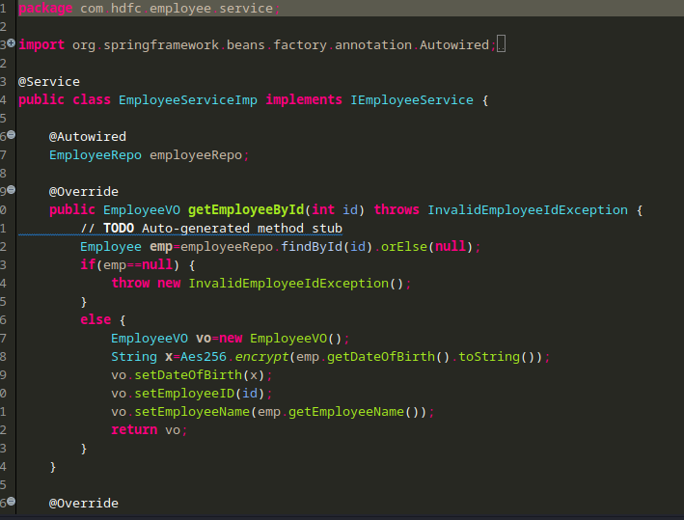
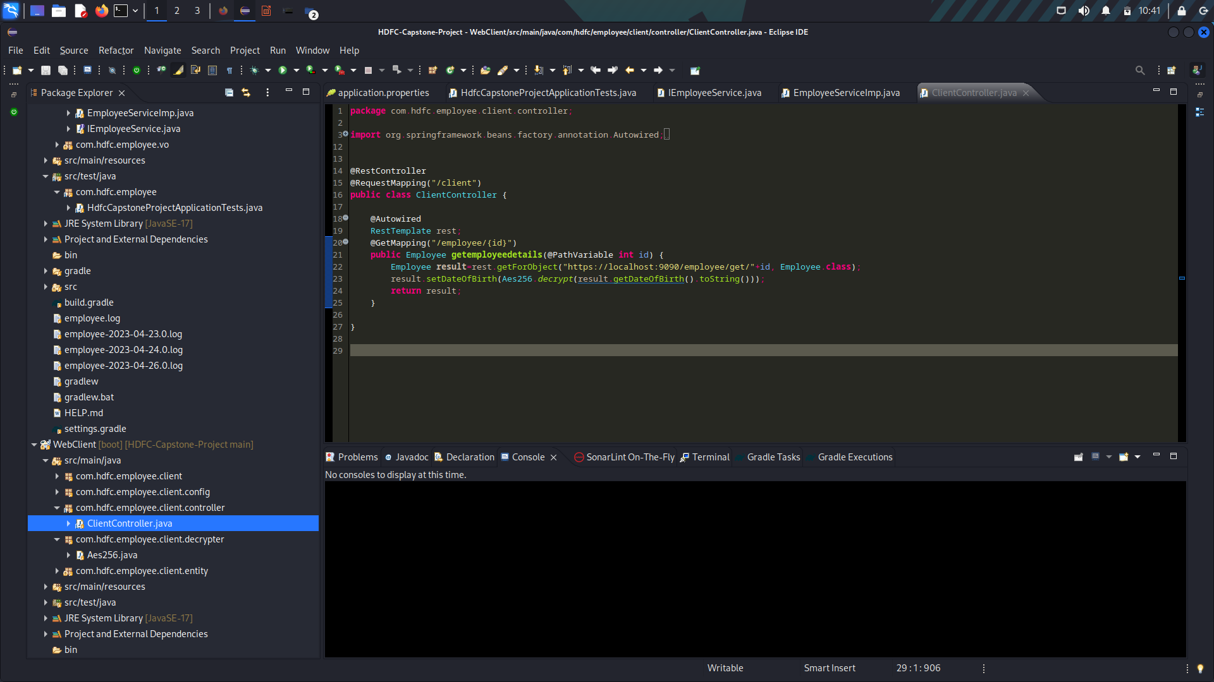
Encryption and Decryption

Slide 9
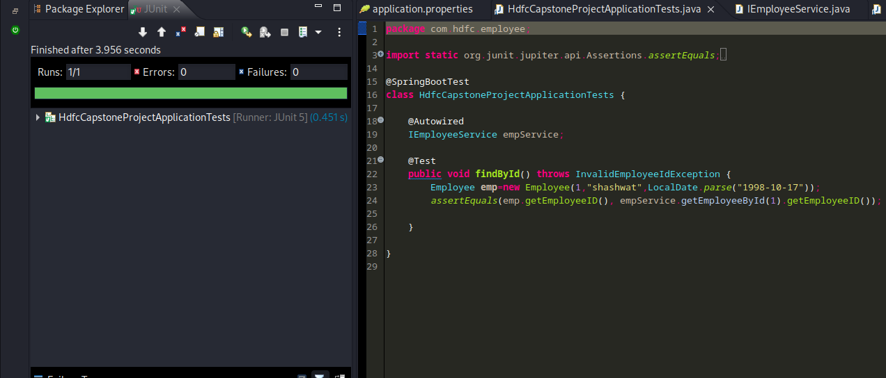
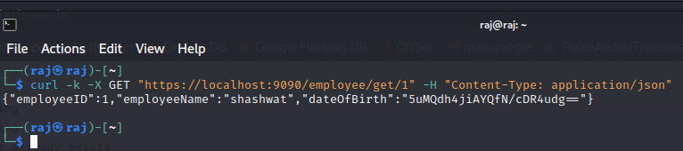
Testing

Slide 10
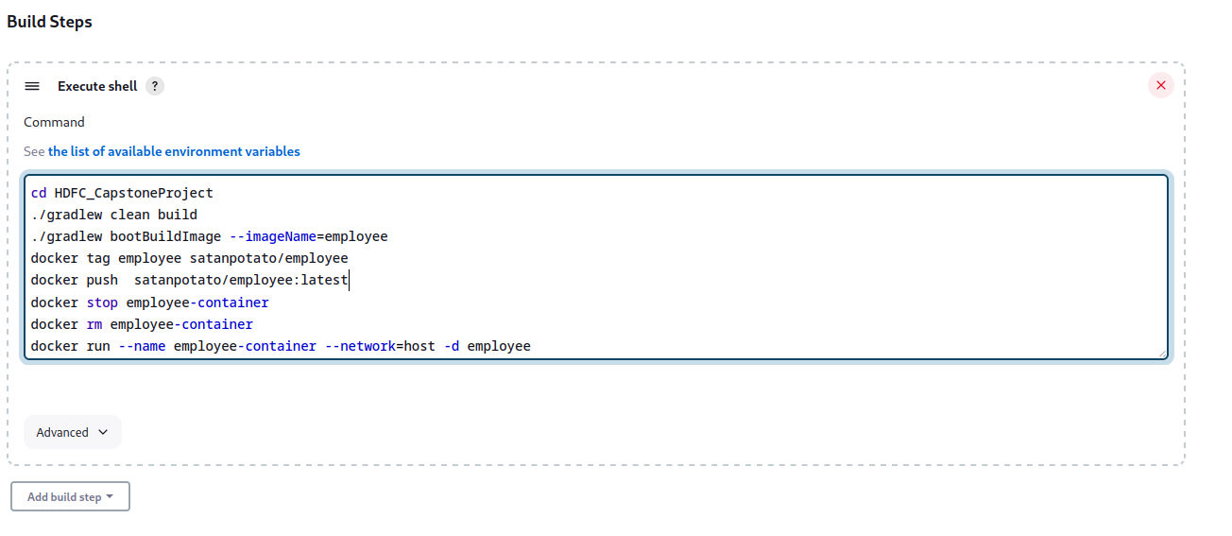
Automation Shell Script

Slide 11
Reamarks
-SSL Validation
-Using docker image of database to run the application
-deploying this image on docker network
-full automation using Jenkins
-Using Kuberentes to deploy docker image

Slide 12
References
SSL Validation: https://www.baeldung.com/java-httpclient-ssl
AES 256 Encryption & Decryption: https://www.baeldung.com/java-aes-encryption-decryption

